Slide 1
Unit 2 What time do you go to school?
Section B 1a-1e

Slide 2
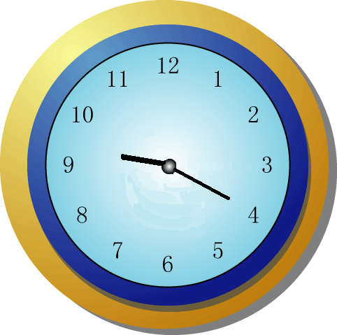
What time is it?
9:30
7:00
4:05
6:25
6:40
6:10
6:00
9:20

Slide 3
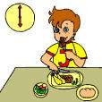
-- What time do you usually…?
-- I usually … at …

Slide 4
Look and say
A: When does Tom usually ____?
B: He________________________.
run
usually runs at five o’clock

Slide 5
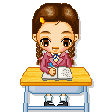
A: __________she _____________
__________?
B: She________________________
_____________.
When does
usually do her
homework
usually does her homework
at eight thirty

Slide 6
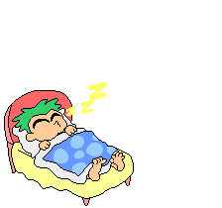
A: __________he _______________?
B: He __________________________.
When does
usually go to bed
usually goes to bed at ten o’clock

Slide 7
work-
take-
get-
eat-
run-
play-
works
watches
watch-
brush-
do-
go-
have-
takes
brushes
gets
does
eats
goes
runs
has
plays

Slide 8
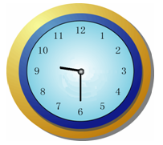
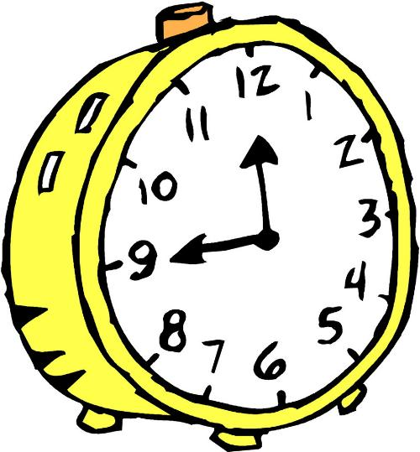
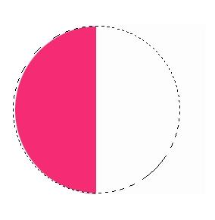
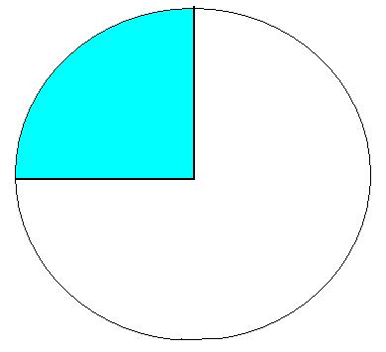
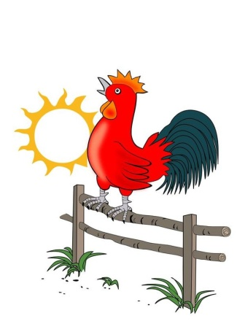
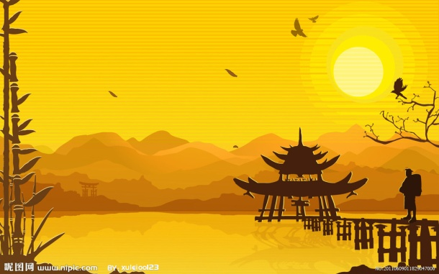
quarter
half past nine
half
a quarter to twelve
a quarter past seven
P.M.
in the afternoon
A.M.
in the morning

Slide 9
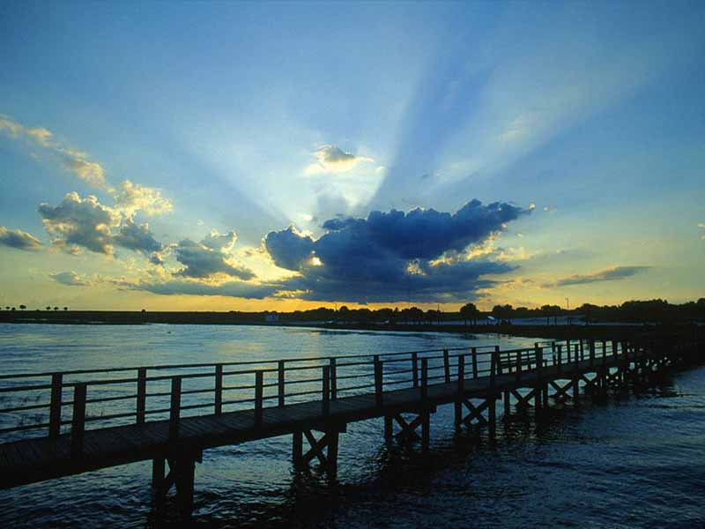
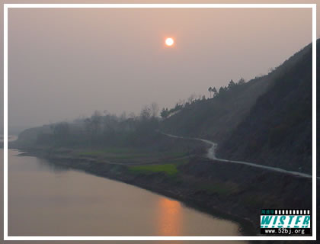
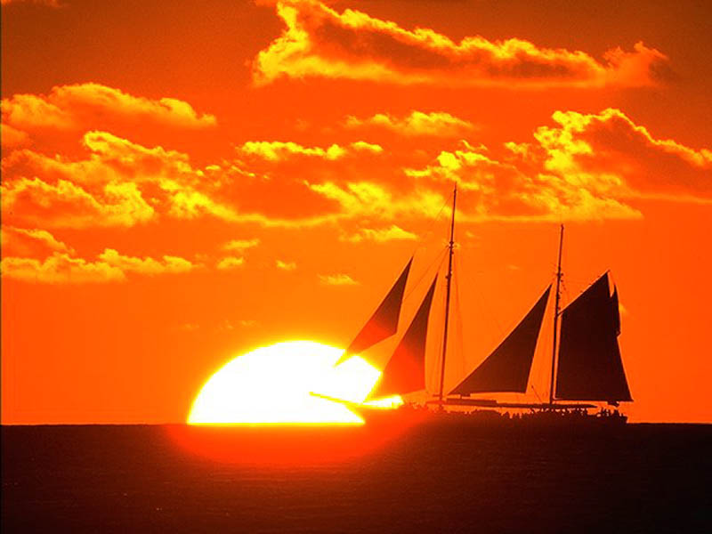
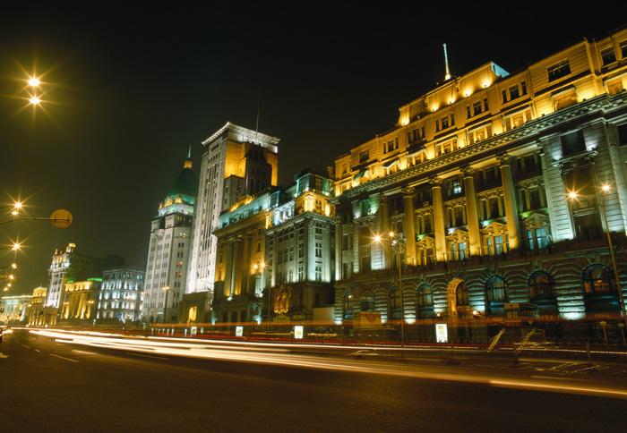
What’s the time of day?
in the morning
in the afternoon
in the evening
A: When do people usually eat dinner?
B: They usually eat dinner in the evening.
at night

Slide 10
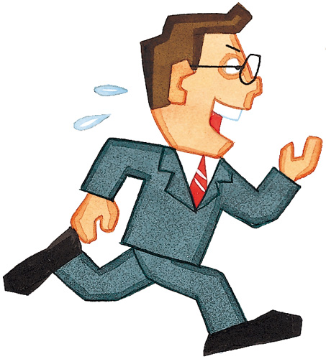
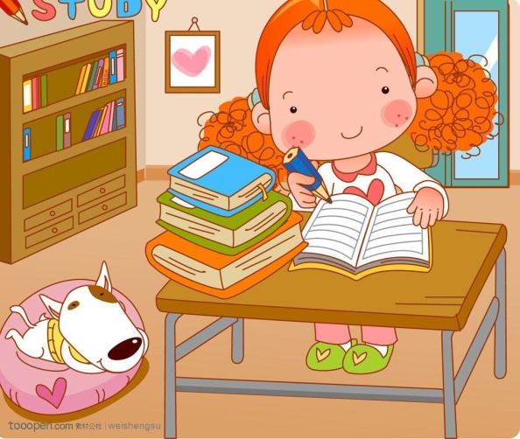
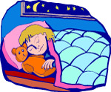
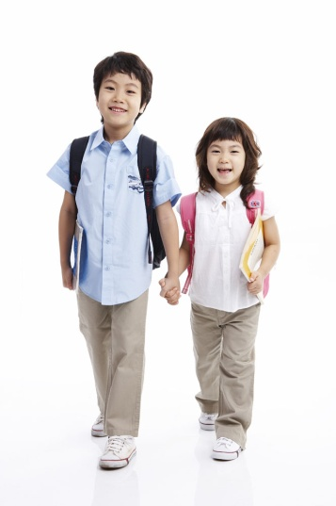
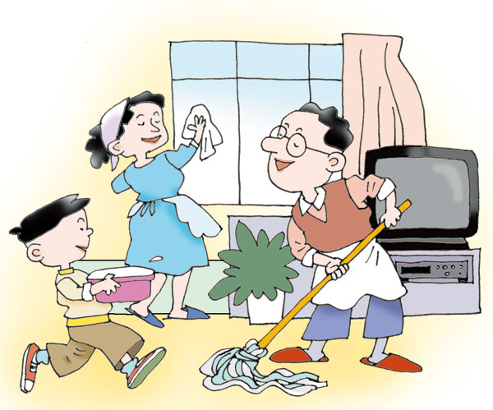
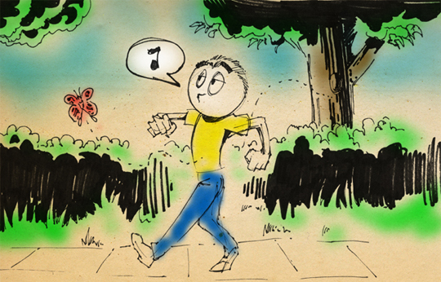
do homework
go to bed
run
walk
take a walk
clean the room

Slide 11
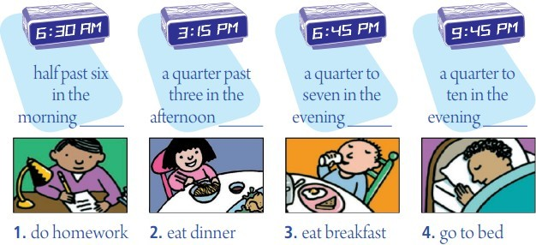
When do students usually do these things? Match the activities with the time of day.
1a
3
1
2
4

Slide 12
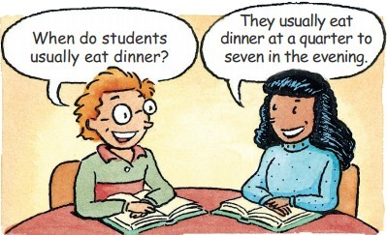
1b
Pairwork
Check your answers with your partner. Do you agree?

Slide 13
1c
Listen and circle the activities you hear.
1. get up ___ 7. clean my room __
2. run ___ 8. eat dinner ___
3. eat breakfast____ 9. take a walk ___
4. go to school ___ 10. go to bed ___
5. go home ___
6. do my homework ___
5:30
6:00.
7:15
7:00
7:45
9:00
4:15
5:30
1d
Listen again. Write the times next to the activities you circled in 1c.

Slide 14
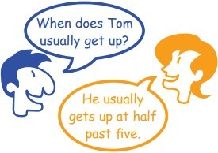
1e
Pairwork
Ask and answer questions about Tom.

Slide 15
get up | 7:00a.m.
eat breakfast | 7:30a.m.
play basketball | 8:15a.m.
take a shower | 11:45a.m.
eat lunch | 12:10p.m.
play computer games | 1:40p.m.
run | 2:30p.m.
watch TV | 7:00p.m.
When does Tom usually …?
He usually … (es/s) at…in the...

